Slide 1



AUTOMATED CAR PARKING SYSTEM
Cornerstone Project Review-1
Department of Electrical & Electronic Engineering
MUDHLEYO THEOPHELOUS (Roll No: 24B11EE076)
MATENDE TREVOR (Roll No: 24B11EE078)
CHEYYETI VEERABABU (Roll No: 25B21EE001)

Slide 2













PROJECT PIPELINE & CONTENT
Introduction
Abstract
Problem & Solution
System Architecture
Proteus Simulation
Prototype Progress
Advantages
Roadmap

Slide 3



ABSTRUCT
Urban Space Constraints
Smart Infrastructure Shift
Automated Management
Urban space constraints means to drive smoothly and city, loan knowing loenmen safety, implient industry, in sense of the constraintance costs and constands with long and in bane urban city places.
Smart infrastructure shift provides approved reet infrastructure model to develop and locally recomponents communication of using and economies acts to as blend and managements.
Automated management technology cent systems, indling, baayreuxic components, and legsaraib, a high global stamaft entirnanement services, analytis, its manalenments and program or auomotity.

Slide 4
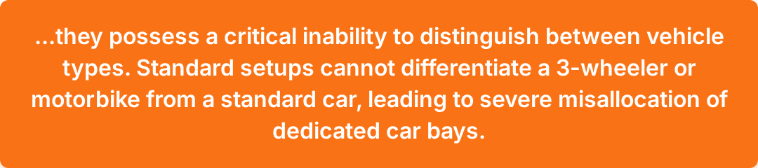




SYSTEM OVERVIEW & THE CRITICAL LIMITATION
While standard automated parking utilizes IR and Ultrasonic sensors for occupancy detection...

Slide 5

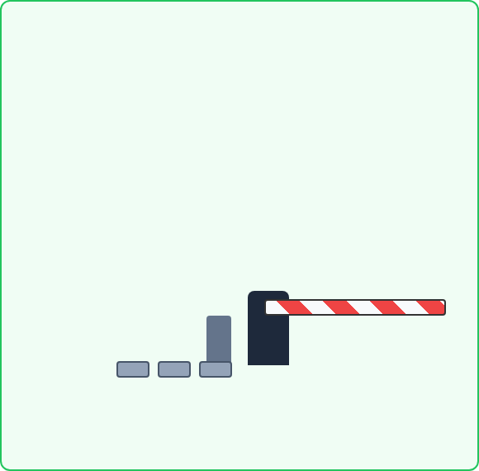

REDEFINING CLASSIFICATION: PROBLEM VS. PROPOSED SOLUTION
Standard Sensor Vulnerability
Smart Weight-Based Classification
Unauthorized non-car vehicles routinely occupy and block dedicated car bays because basic proximity sensors grant them access.
Integration of 4 weight sensors (load cells) beneath the parking bays to measure vehicle weight class.
If weight ≠ car threshold ➔ System Rejects Vehicle ➔ Gate Remains Closed

Slide 6

















SYSTEM ARCHITECTURE & DATA FLOW
Zone 1: Sensing (Input)
Zone 2: Processing (The Brain)
Zone 3: Actuation & UI (Output)
Ultrasonic Sensor
L298N Motor Driver & DC Motors
ESP32 / Arduino Nano
Microcontroller Unit
4x IR Sensors
20x4 LCD Display
4x Weight Sensors / Load Cells
IoT Dashboard

Slide 7

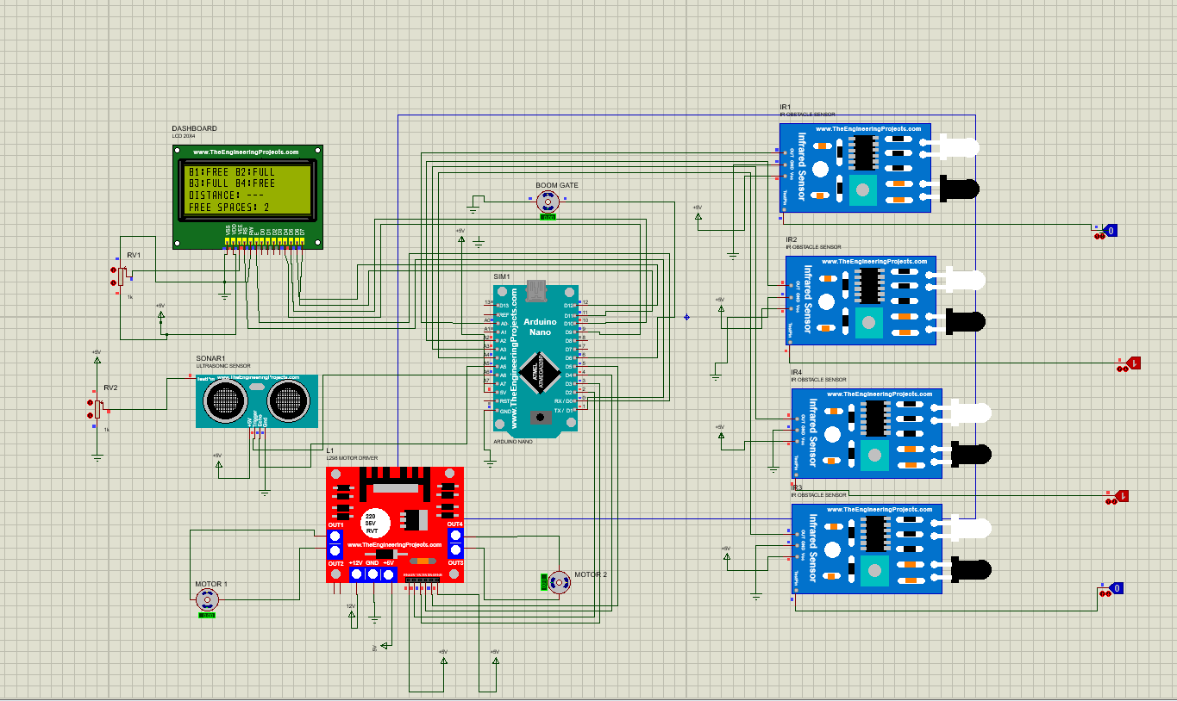
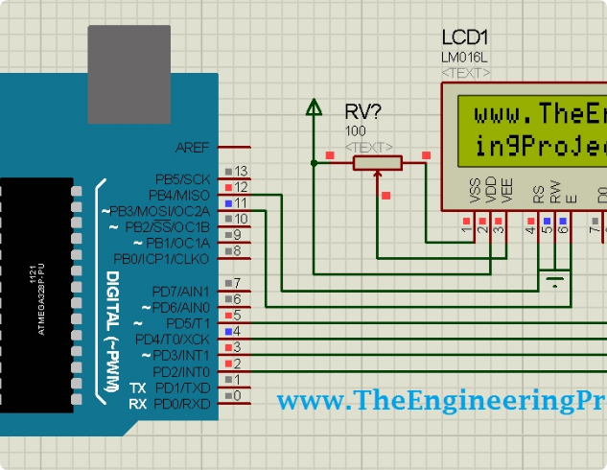





HARDWARE ANATOMY & PROTEUS SIMULATION
Side-Panel Legend
Central MCU: Arduino Nano managing the logic gates.
Entrance Detection: Ultrasonic sensor (SONAR1) wired for approach triggering.
Bay Occupancy: Array of 4x IR obstacle sensors monitoring individual slots.
Actuation Driver: L298N Motor Driver bridging the MCU and the physical gate motors.
Local UI: LCD 20x4 wired for immediate status readouts.

Slide 8






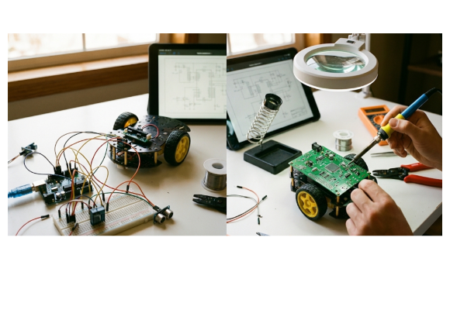
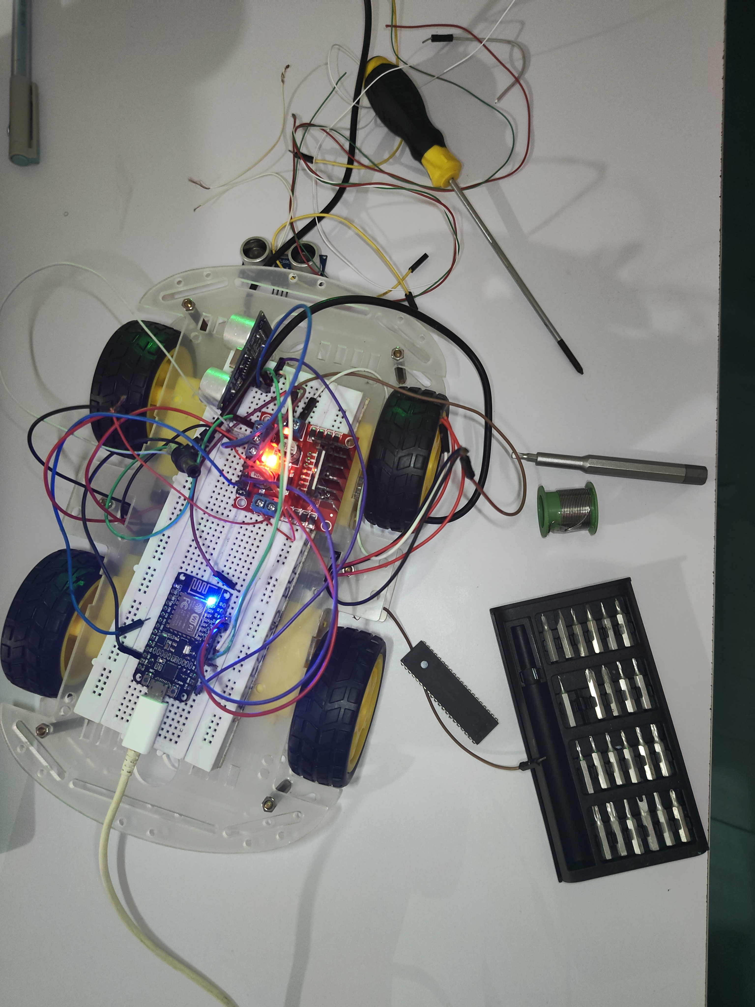


MILESTONE: PHYSICAL PROTOTYPE BUILD
https://drive.google.com/file/d/1xlCHq_maRsiIqmdQXVsxad6pYqJBEqmQ/view?usp=sharing

Slide 9






CORE SYSTEM ADVANTAGES
Smart Weight-Based
Classification
Automated Access
Control
Exclusively reserves car bays for standard vehicles by actively rejecting underweight 3-wheelers and motorbikes.
Seamlessly operates the barrier gate via precise motor control, eliminating the need for manual ticketing personnel.
Real-Time Occupancy
Tracking
Zero Manual Intervention
Creates a fully autonomous loop from vehicle approach to bay assignment, optimizing flow and reducing operational friction.
Provides instant visual feedback on bay availability through local LCD interfaces and cloud-synced IoT dashboards.

Slide 10

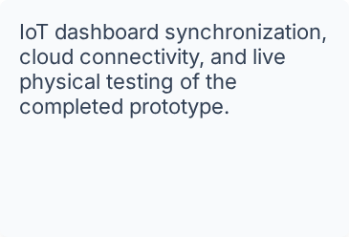

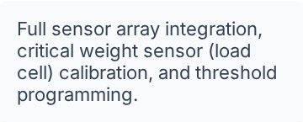

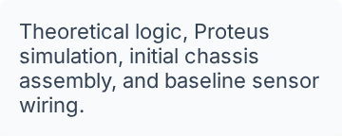
PROJECT ROADMAP: PATH TO REVIEW-2
Review-2 Deliverable
(Upcoming)
Calibration Phase
(In Progress)
Review-1 Phase
(Completed)
Ready for subsequent integration. Opening the floor for technical review.

Slide 11

THANK YOU
Any Questions?

